Slide 1

Prepared by Boaz Refael Matan
Home Assignment - RAG System
KPMG's Applied AI & Machine Learning Assessment
31 March, 2025

Slide 2



Project Objectives
Goal
Solution
Documents
Build a Retrieval-Augmented Generation (RAG) system to answer queries using provided historical/industrial documents.
LangChain-based system with smart prompts and topic-aware filtering.
Food
Steel
Textile
Automobile

Slide 3
System Architecture
Document loading from DOCX files
Recursive chunking with titles and headers
Embedding using OpenAI
Vector storage with Pinecone
Topic filtering (food, steel, textile, auto)
Smart prompts tailored to query type

Slide 4
Prompt Engineering Strategy
Ambiguous: Ask for clarification
Misspelled: Leverage semantic embeddings
Contradictory: Graceful ‘no-answer’
Why / How: Specialized reasoning prompts
Short / Vague: Prompt for more context

Slide 5
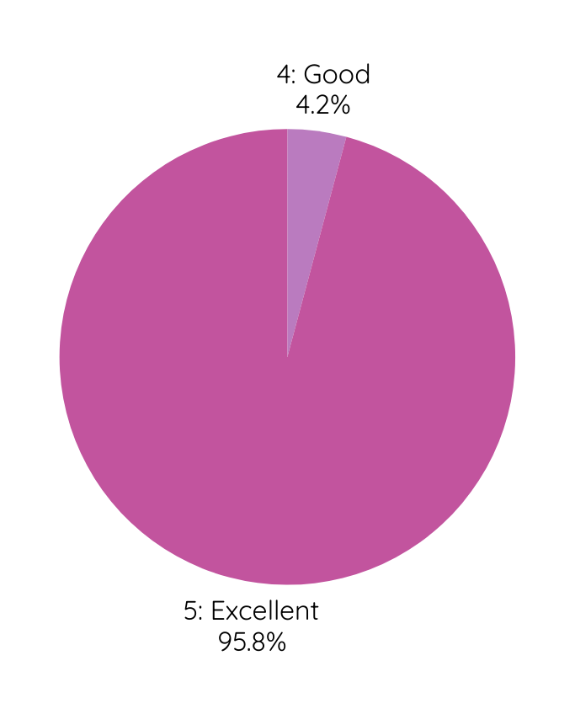
Edge Case Coverage
Scoring Criteria (0-5) scale:
0: Failed to answer
1: Incorrect or misleading
2: Weak
3: Adequate
4: Good
5: Excellent
24 test queries:
Ambiguous,
Misspelled
Vague
Partial
Contradictory
Rare entities
Multi-topic
Used ‘debug_retrieval() to trace chunk relevance
Final system score: 4.96 / 5 average

Slide 6
Debugging & Fixes
Added document titles and section headers to chunks
Used topic metadata for filtering and fallback search
Improved prompts for definition, reasoning, and comparison
Fixed issues with Fordism, Lean vs. Fordism, timelines

Slide 7
Final Evaluation Results
23 of 24 answers scored 5/5
1 answer scored 4/5 (short input)
Zero Hallucinations
Polished fallback and topic control

Slide 8
Project Assets
`KPMG_Solution.ipynb` - main notebook
`kpmg_rag.py` - main Python script (similar to notebook)
`README.md` - steup & usage
`requirements.txt` - dependecies
Debug and evaluation modes included

Slide 9

Next Steps
Model Enhancements
Add hybrid keyword + semantic search
Consider re-ranking with GPT or other rerankers
Explore retrieval tuning using rerankers or multi-vector search
Use LangChain Agents for follow-up query handling
User Experience & Interaction
Add visual outputs: charts, timelines
Add streaming support for partial or live responses
Deployment & Integration
Deploy as an API using FastAPI or Flask
Apply metadata filters via CLI (e.g., data range, topic)
Package as a pip-installable library for reuse in other teams
Feedback & Improvement
Add Feedback collection and logging for continual improvement

Slide 10

Design Choices & Thought Process
Core Technology Choices
Chose LangChain for modularity and ecosystem maturity
Used Pinecone over FAISS due to hosted scalability and real-time performance
Alternatives considered: Chroma for local vectors, FAISS for GPU performance, native OpenAI RAG without LangChain
Accuracy Optimization
Optimized for accuracy by including section headers in chunks
Applied semantic filters based on inferred topics
Prompt tuning provided the biggest boost to relevance and reliability in edge cases

Slide 11
Design Choices & Thought Process
Smart Prompting Strategy
Added prompt tailoring for different query types:
“why”, “how”, “define”, vauge, short, ambiguous, contradictory, etc.
Trade-offs Considered
Accuracy vs. Speed:
Chose smarter prompts and richer context over minimal latency
Cloud vs. Local vector DB:
Prioritized ease of deployment with Pinecone

Slide 12
Conclusion
Built a modular and accurate RAG system using LangChain, OpenAI and Pinecone
Designed to handle a wide range of queries with prompt eng. and topic filtering
Achieved 96% success rate across 24 edge-case tests
Clean, testable, and ready to scale or adapt
Prepared for real-world usage: CLI, APP, frontend integrations, and team reuse (Will provided separately)
Ready for further innovation and deployment

Slide 13
Thank you

